Slide 1

Mining for Client Solution Adoption
Chen Zhao, Ikaika Bostwick, Peter Quach, Sam Wareing

Slide 2

Researches Product Trends
Persona
Directs her team to do the right work at the right time
Contends for team funds from executives
Very busy schedule
Alice
z/OS Offering manager

Slide 3

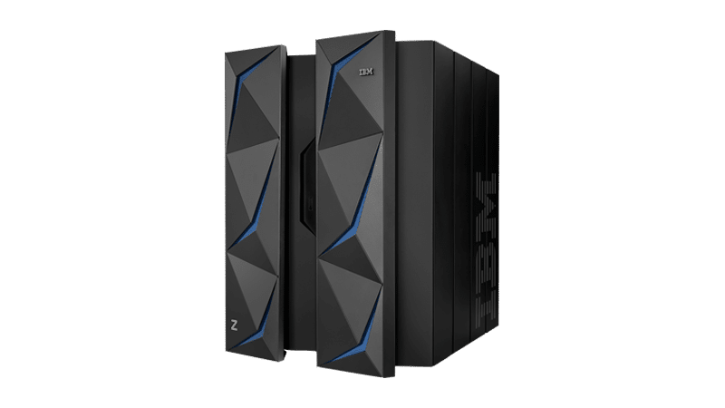
Problem
Which solutions are our clients using?
Alice wants to efficiently direct her team to do the right work at the right time
If she knew which solutions clients were using, it would be easy
Information about client solution adoption is sparse and time consuming to acquire.
Notes:
As-is Scenario:
Alice reaches out to her team's product architects and asks them to provide solution usage statistics
The architects sift through available data (PMRs, APARs, RFEs etc) manually to determine solution usage
Several weeks later, Alice receives the solution usage statistics in a raw data format
Alice converts the raw data into meaningful visual representations to present to executives
In the words of Ceci:
As-is 1. go to architects
2. architects go to level 2 (or do it themselves)
3. architects/L2 mine the data (PMR data) -> determine what is being used
3a. Lots of manual work -> no standardization
3b. Very time consuming
4. Since L2 is usaully busy helping customers, archs end up doing it a lot
5. given back to OM in "raw data" form
6. OM has to figure out how to present this information

Slide 4


Problem
This is a lot of work
Once Alice finally gets the information she needs (often several weeks later), it is in raw data format
Alice can analyze the data to determine what her team should work on, but she also needs the resources allocated so that her team can do the work
She must manually convert the data into meaningful visual representations to present to executives

Slide 5

Solution
Alice, the offering manager, wants to find out which solutions clients are adopting
She opens her web browser and launches the Client Solution Adoptions web app
From the app she uploads or queries the data from RTC, selects the data she would like visualized, and clicks "submit"
Within seconds she has the information and visualizations she needs

Slide 6
Hills
Alice, the offering manager, can mine PMR data to better understand which products and features the customers are using within a certain time frame, in a matter of seconds, so that her team can prioritize their feature development.
Alice, the offering manager, can visually represent customer usage of the top 10 features from the PMR analysis in as little as 5 clicks on her personal computer.
Notes:
Ikaika add number of clicks to second one
Make second one more measurable
With little to no effort --> a couple clicks
Who: Alice
What: the charts
Wow: in just a few clicks remove team funding
Focus on "on her own" -> wow, she doesn't need to reach out

Slide 7
Business Impact
High interest by management
Management, in all areas of z/OS, are interested in having easy access to information about client adoption of their teams' solutions
Most go through a similar process as Alice to acquire this information
Potential to be expanded
The tool looks primarily at PMR data, but could be expanded to any type of RTC workitem
Could be made accessible to other parts of IBM that use RTC
Highly feasible
The data is already available
Mining the data is relatively simple
TLDR; Pulls useful, hard to acquire information from data that is easily accessible, saving time, money, and resources
Notes:
Ikaika
Potential business impact:
- vehicle for management to quickly identify the information
- right now, PMRs only -> could be expanded to RFEs - PMRs are one piece of information that help management identify the how quickly customers are adopting solutions
- expanded to look at trends in client solution adoption
- people are interested in this

Slide 8
IBM Design Thinking and Agile
Our team met every Tuesday in person for at least one hour
Planned and discussed concepts
Split workload and helped each other with parts
Frequent meetings with mentors after completed segments
Made sure the path is correct
Multiple redesigns and direction change for sunk cost was too much
Working meetings were scheduled to finish on time
Pair programming and face to face debugging
Notes:
Peter part of process: - presented a playback to an OM -> got good feedback
- several different iterations of product (VBA -> python -> web) -

Slide 9
IBM Design Thinking and Agile
Iteration 1
Planning
Meetings w/ Architect and Designer
Identify pain points
Draft 1: VBA coding in Excel
Take PMR text and tag features
Iteration 2
Draft 2: Switch to Python
VBA dead language
Not so user friendly
Backend programming
Presentation to Z/OS Offering Manager
Turned away from generating tags
Not the main goal
Iteration 3
Refocused on main points
Many ideas for side features
Deployable Web Service
Django, IBM Cloudant, Python
Front end development
Create graphs
Create options for user
Notes:
Peter part of process: - presented a playback to an OM -> got good feedback
- several different iterations of product (VBA -> python -> web) -

Slide 10
Epic and User Story Map
As a user friendly application, I want to analyze tagged PMR data to determine features used by Z/OS customers.
As an offering manager, I want to pull relevant data from problem management reports (PMR).
As an offering manager, I want to determine which features are in production, proof of concept, and test.
As an offering manager, I want to determine which features are being used most by customers.
As an offering manager, I want to determine which features a specific customer is using.
As an offering manager, I want to visually represent the data analysis of tagged PMRs
As an offering manager, I want this Web User Interface to have features for multi-select for tags and customers as well as predetermined selections for graphs.
As an offering manager, I want a variety of visuals and selections
Notes:
Peter

Slide 11
Design
The Thing: Simple web app to process RTC data in order to visualize client adoption of z/OS solutions
The Data: Uploaded or queried data from Ration Team Concert work items (PMRs, RFEs, etc) (prototype expects pre-tagged data, i.e. with tags such as prod:: test:: or poc:: to identify stage of deployment)
The Process: Extract statistics about client solution adoption and visualize them using Python libraries.
The Interface: A web app developed using the Django Python web frame work hosted on IBM Cloud.
Notes:
Chen
* add details about prod, test, poc tags prod::
Test::
Poc:: L2 -> knows the tagging convention and tags PMRs approrpiately

Slide 12
Architecture Diagram
User
GUI
Backend
IBM Cloud
Notes:
Chen

Slide 13
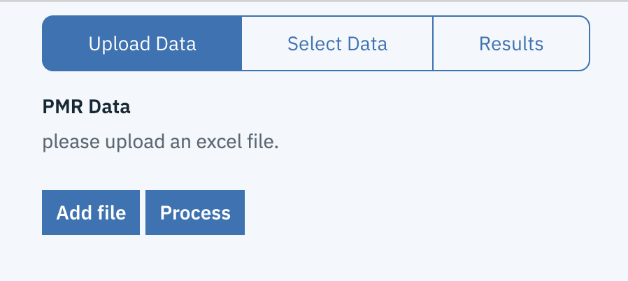
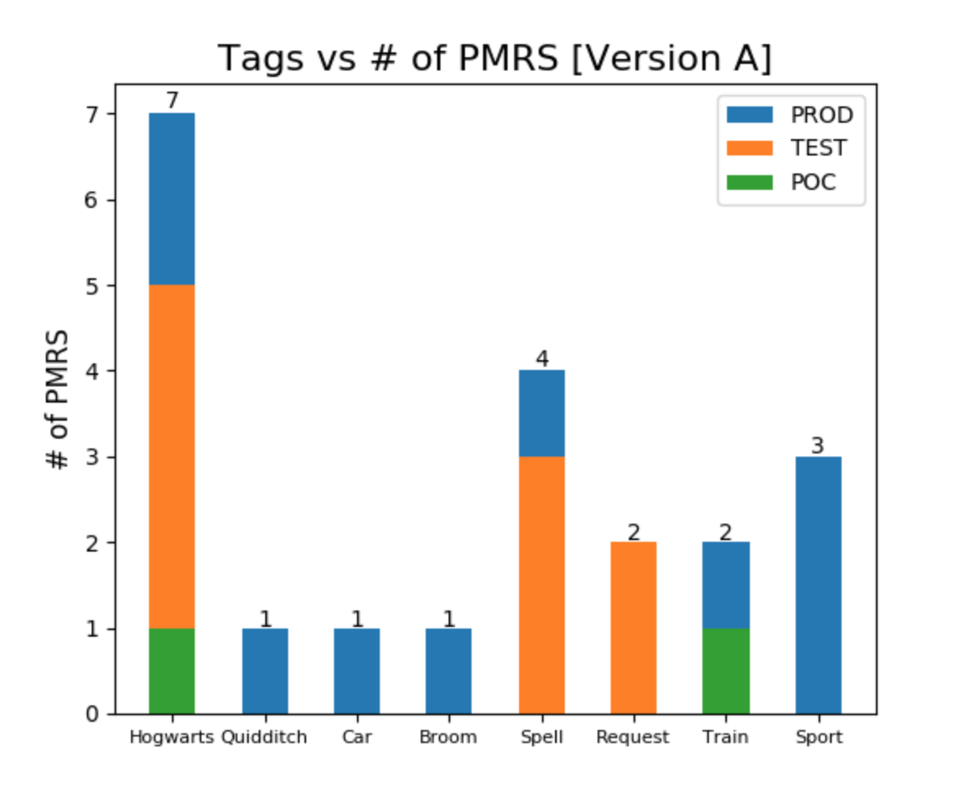
Proof of Concept
Using IBM Bluemix as the host of the web application
Combine the User Interface with our backend python
Able to upload local data or pull data via RTC
Mine data and display on graphs with as low as 4 clicks

Slide 14
Live Demo https://pmrminer.mybluemix.net/home
IBM Analytica / Team 6/ January 17, 2019 / © 2019 IBM Corporation

Slide 15
Questions?
IBM Analytica / Team 6/ January 17, 2019 / © 2019 IBM Corporation

